Slide 1
Penn State Abington
CMPEN 271
FALL 2017
Instructor: R. Avanzato
Chenning Zhang Computer Science ccz31

Slide 2
The output to this circuit are three, 7-segment LED displays.
Design and simulate a BCD ripple counter with the MOD-368.
Include timing diagram markups for 2 counts before the reset to 0, cout = 0, and 2 counts after the reset to 0.
Include critical portions of the timing diagrams with annotations
Show count values in both binary and in decimal. Label msb and lsb for each counter/ digit.

Slide 3
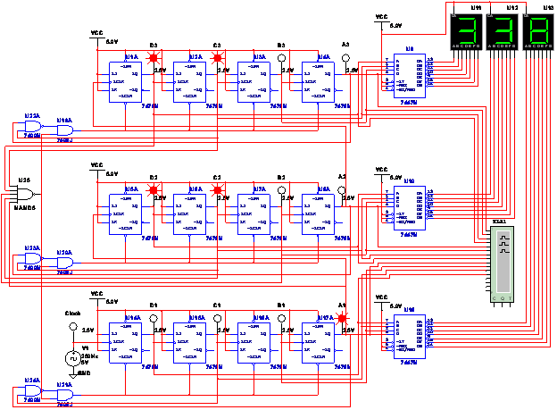

Slide 4
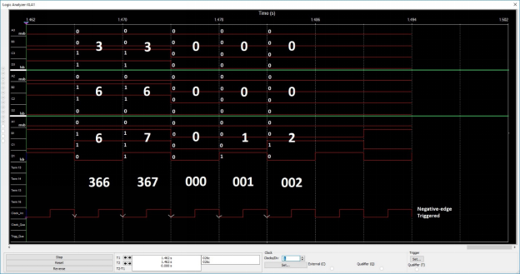
MSB
LSB
MSB
LSB
MSB
LSB

